Slide 1
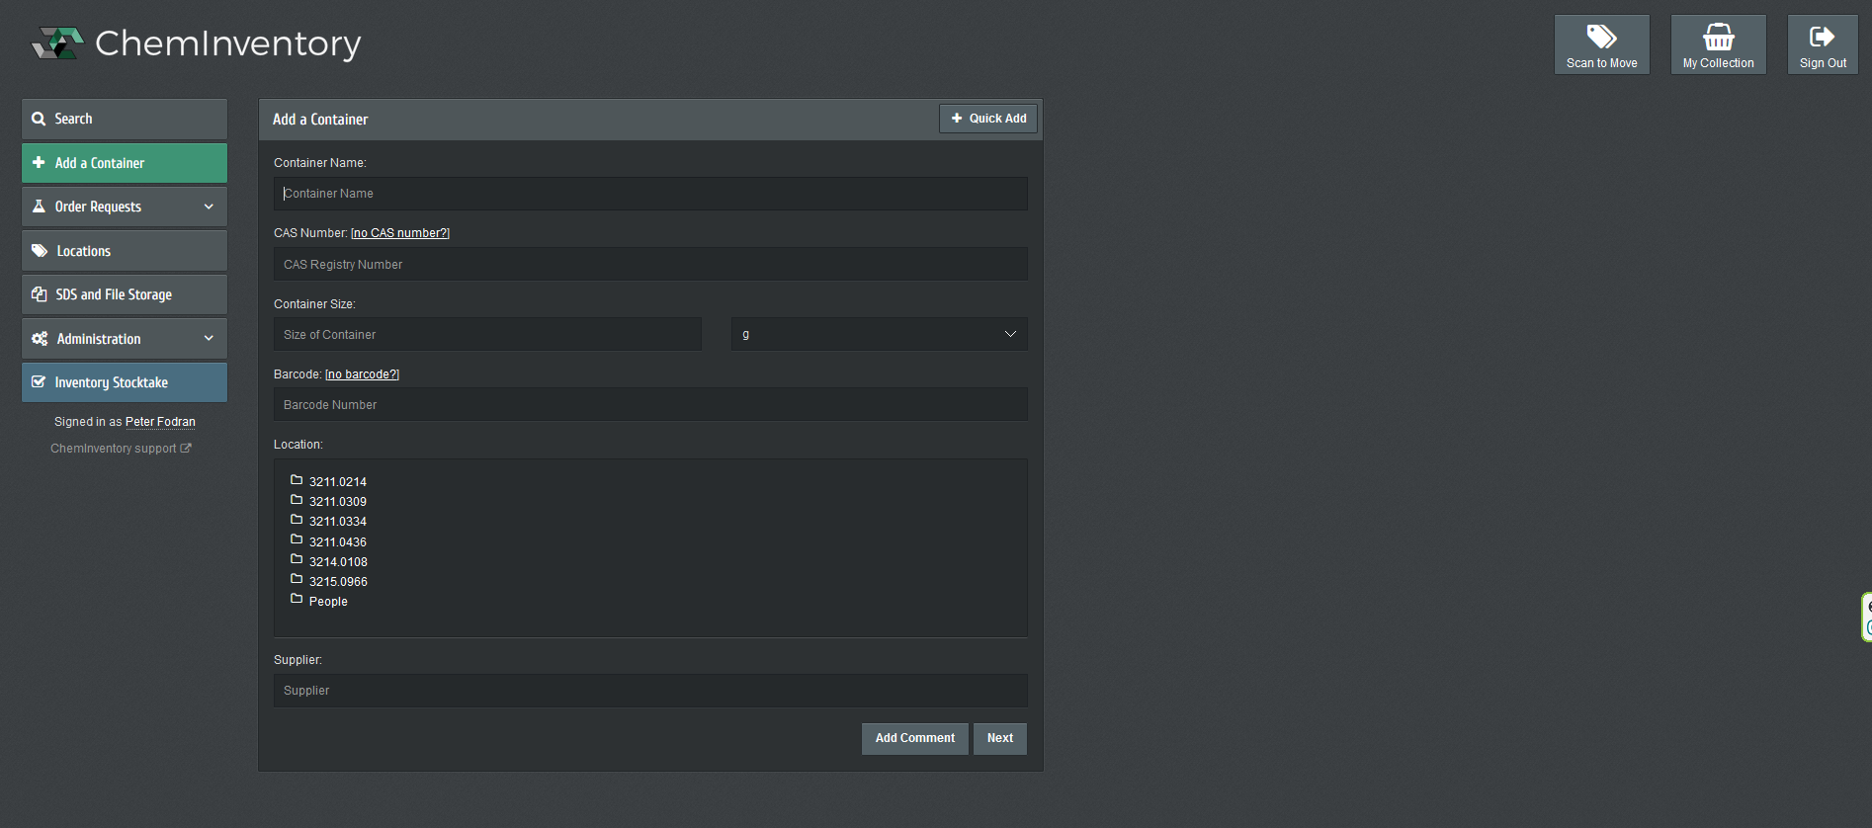
Go to add a container

Slide 2
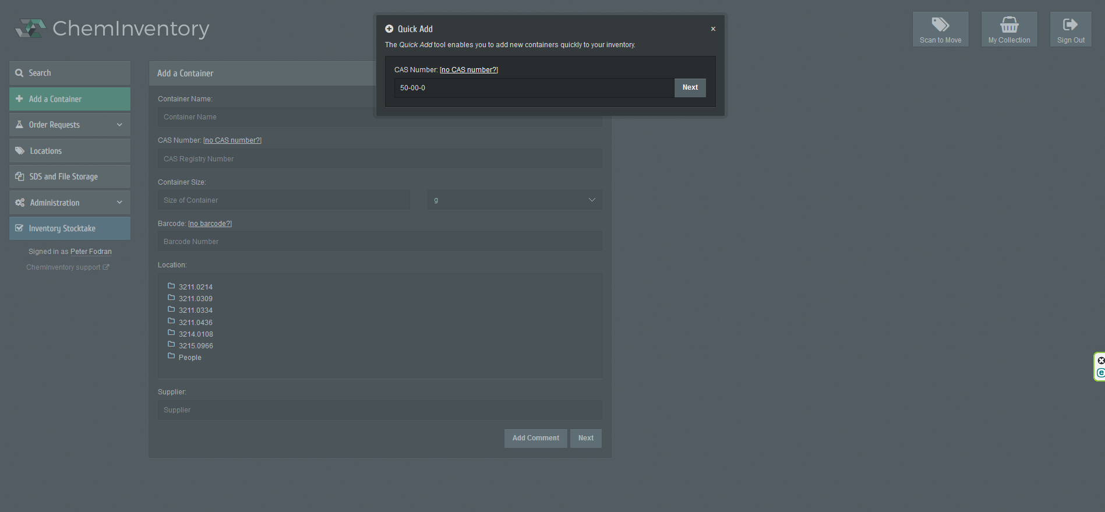
Click quick add

Slide 3
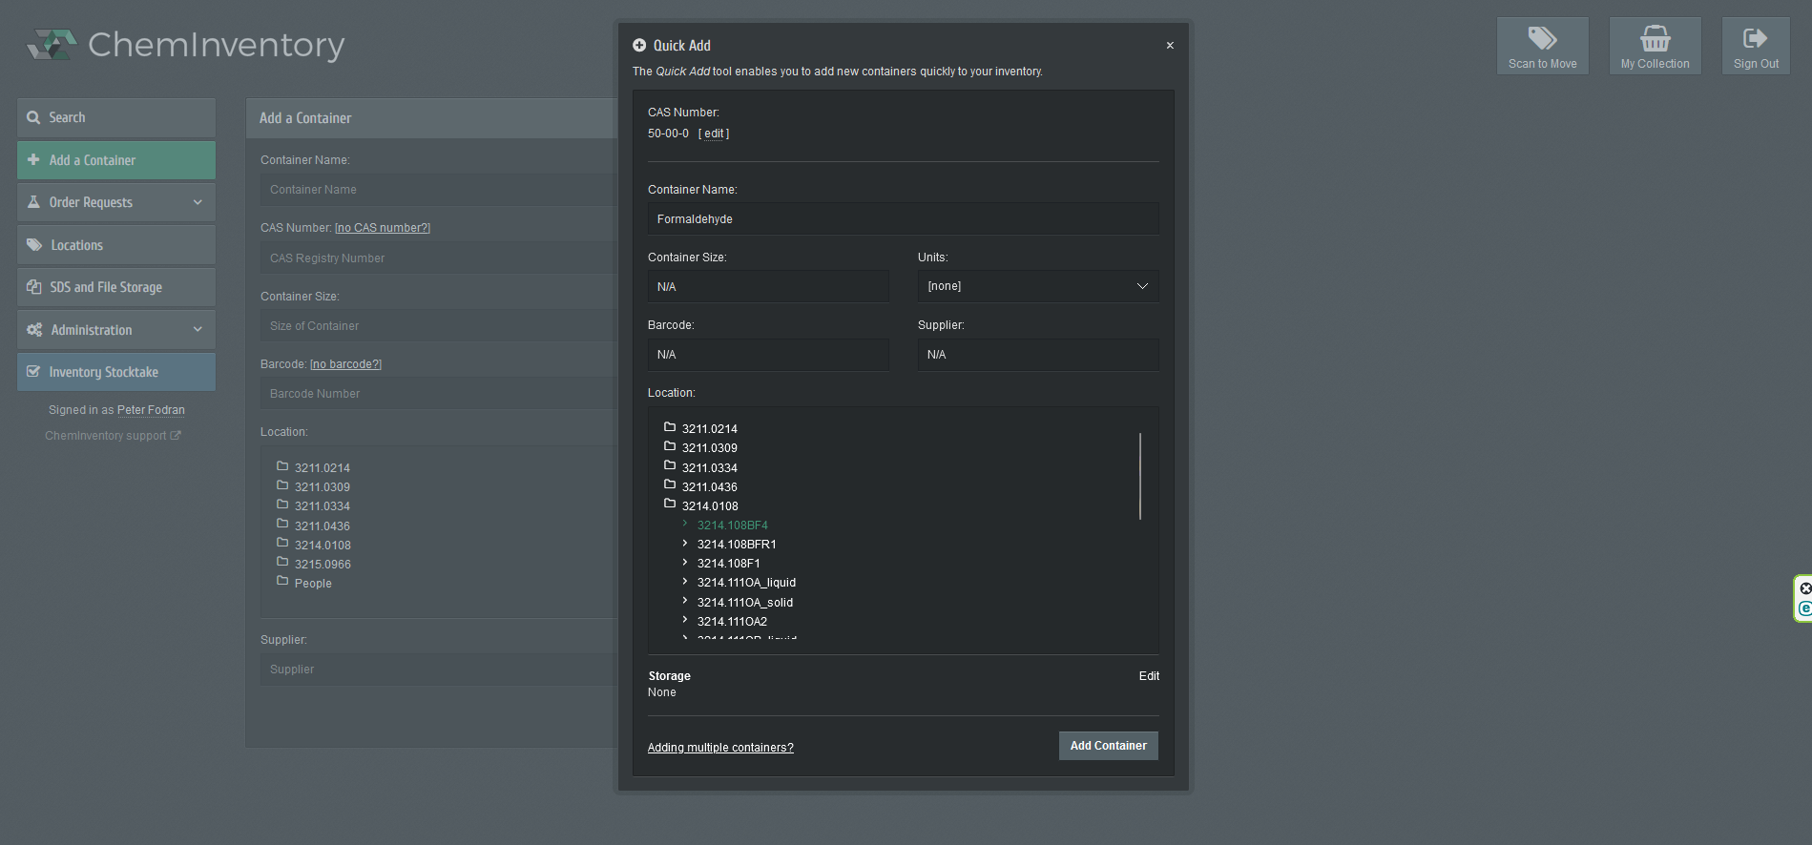
The name is generated automatically from the CAS number
Add container size, Units and Supplier – this greatly helps in identifying the chemical
Just click add container

Slide 4
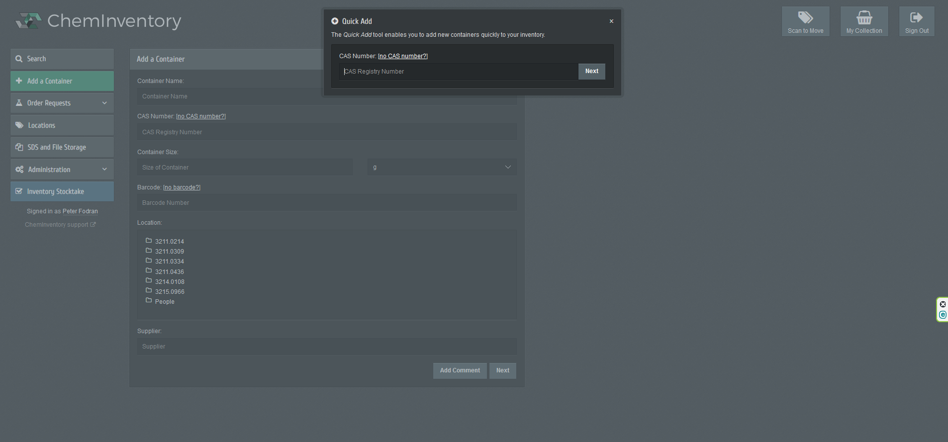
Done!

Slide 5
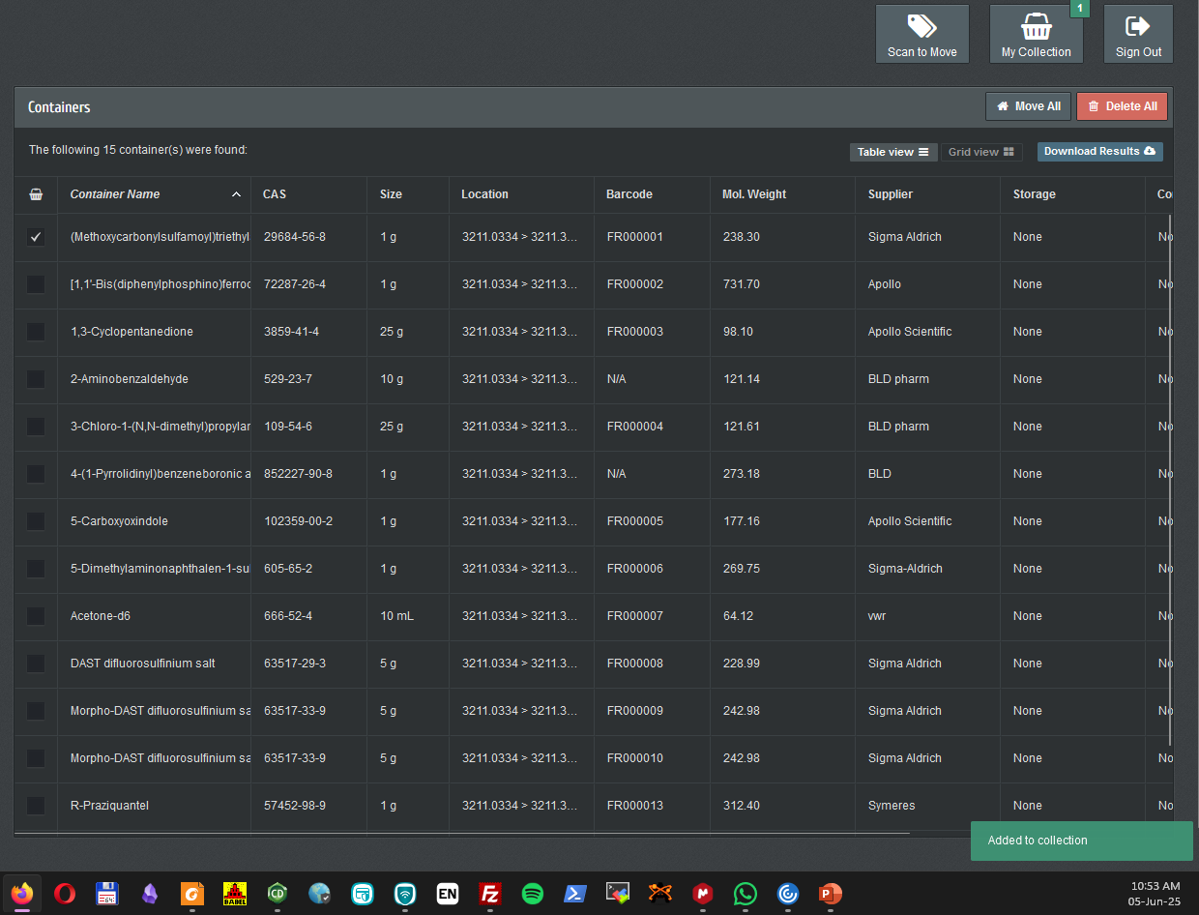
Moving chemicals: tick the chemical you want to move
Go to My collection in top right corner

Slide 6
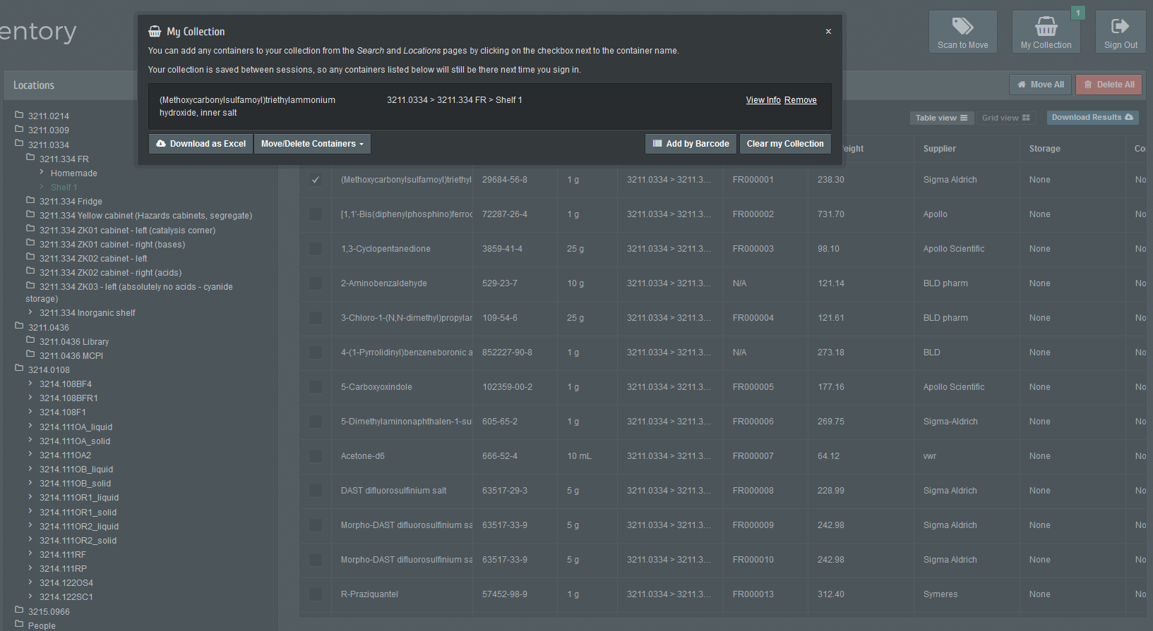
In the dialogue window, click move/delete containers

Slide 7
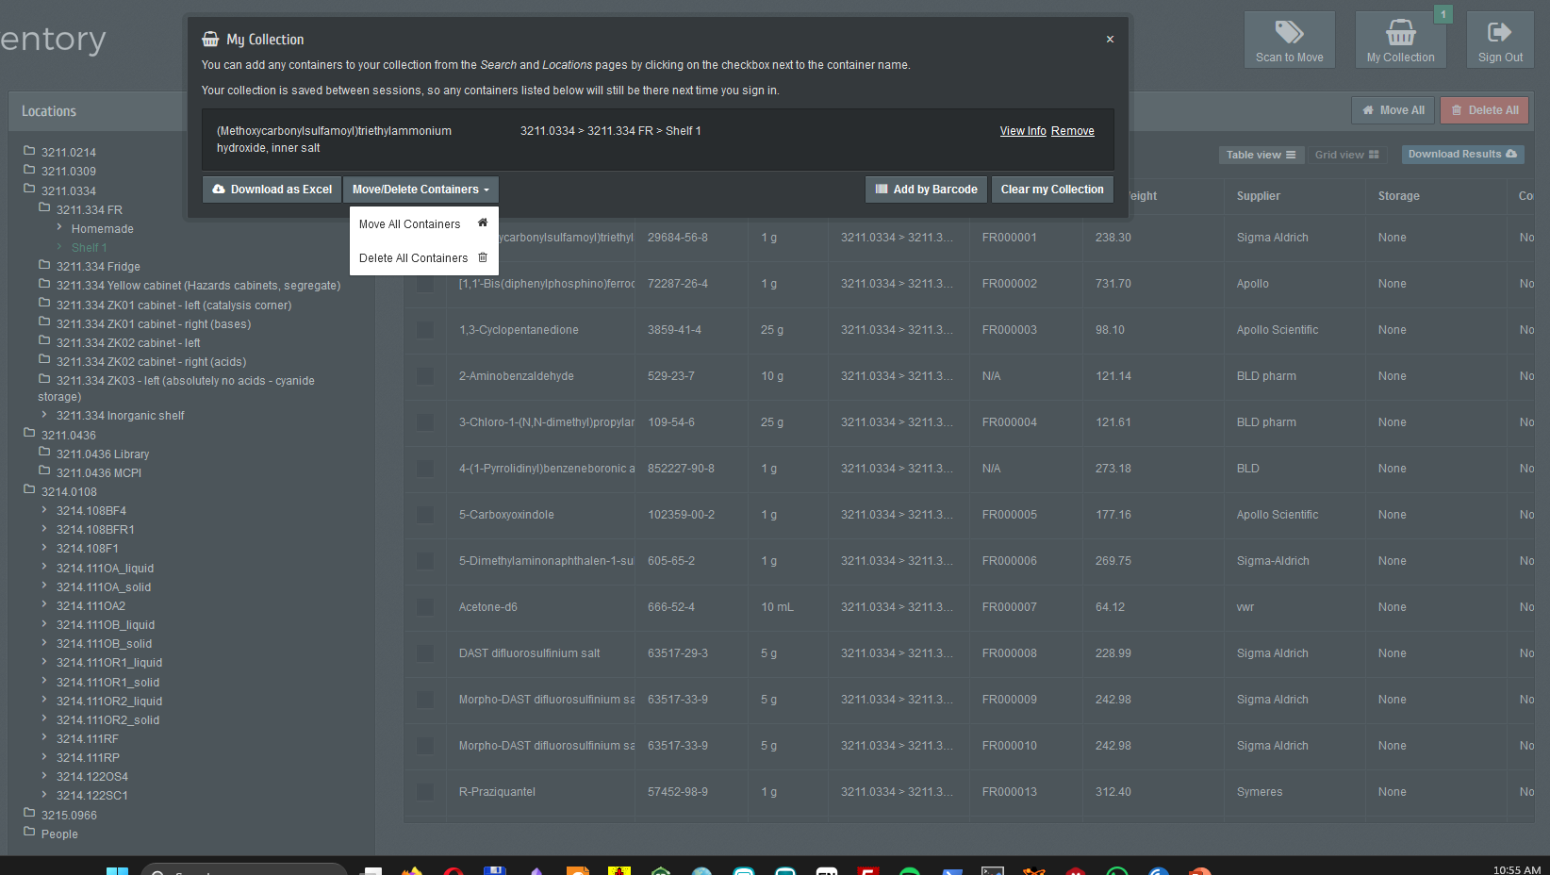
Choose move all containers

Slide 8
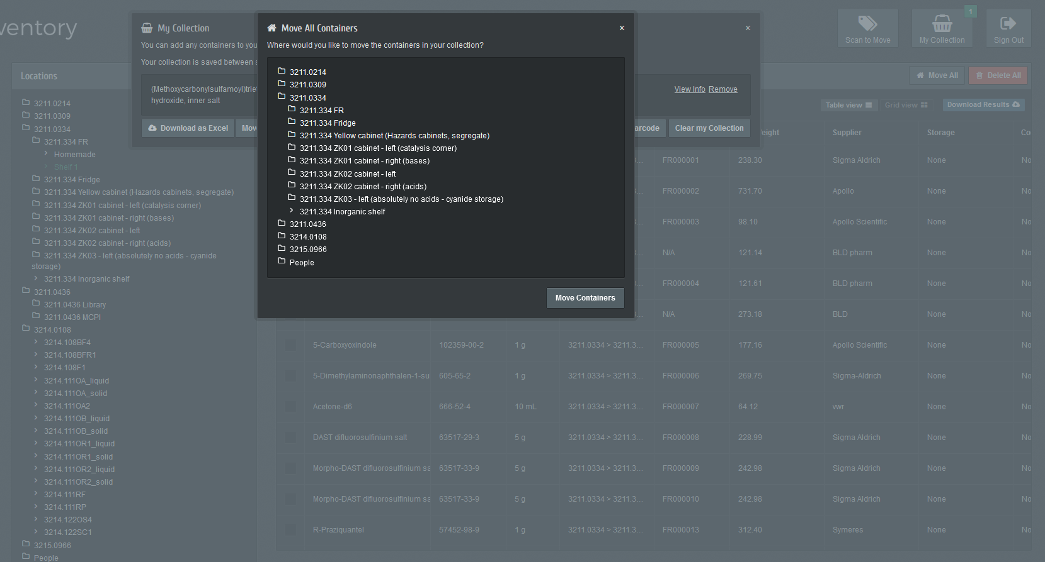
Tick the location and click move containers
Done

